Slide 1


RUMOR DETECTION ON ONLINE SOCIAL NETWORKS TEAM MEMBERS
T SAI SREENATH 21861A6647
D DIVYA 21861A6647
M AKSHITHA 21861A6634
K SAHITHI 21861A6628
K SHIVA CHARAN 21861A6627
Under the Guidance of
Mr. burla srinivas
Assistant Professor

Slide 2



CONTENTS
Abstract
Introduction
Literature review
Proposed model
Results
Conclusion
Future scope
References

Slide 3
Abstract
Rumor Detection on Online Social Networks is an emerging field within data science and machine learning, focusing on identifying and classifying rumors on social media platforms.
Existing rumor detection systems often require expensive hardware, specialized software, or complex configurations, making them inaccessible for the general public or developers.
Most research in this domain concentrates on theoretical models for rumor detection, rather than on practical software solutions that can be easily implemented and accessed.
The purpose of this project is to develop a real-time rumor detection system that is more accessible to users and developers without requiring costly equipment or complex setup.
The system aims to offer an efficient, scalable solution for detecting rumors on social media platforms, ultimately making this technology more available to a broader audience.

Slide 4
Introduction
Social Networks and Information Spread Due to their ability to facilitate quick information sharing, online social networks have become an indispensable aspect of daily life. But this quick dissemination also makes it easier for rumors and misleading information to propagate.
Problem Statement Because of the large volume of data and the rapidity of information dissemination, detecting and managing rumors is a difficult task. Because social media platforms are dynamic and real- time, traditional rumor detection techniques frequently fail.
Importance of the Issue societal media rumors have the potential to spread false information, cause societal instability, and even hurt people or organizations. It is essential to identify these rumors accurately and promptly in order to stop their detrimental effects.

Slide 5
Existing Solutions: Machine learning, natural language processing (NLP), and sentiment analysis are some of the methods that have been put out for rumor identification. However, the scalability and real-time performance of many of these methods are constrained.
The goal of the project is to create a scalable and effective rumor detection system for online social networks. The technology uses text analysis and machine learning techniques to automatically detect any rumors and categorize them as real or untrue.
Methodology: To identify rumors, this study entails gathering information from social media sites like Twitter, using feature extraction methods like sentiment analysis and keyword recognition, and training machine learning models

Slide 6
Objective
Design a robust machine learning model to detect and classify rumors from online social media data, particularly focusing on Twitter.
Implement feature extraction techniques, such as sentiment analysis, TF-IDF, and POS tagging, to process and analyze the text data for identifying potentially false or misleading information.
Train and evaluate multiple machine learning algorithms to determine the best-performing models for rumor detection, considering factors like accuracy, precision, recall, and F1-score.

Slide 7
Literature Review
Rumor detection in social networks has gained significant attention due to the rapid growth of user-generated content.
Early models primarily relied on traditional machine learning (ML) techniques such as Naive Bayes, Random Forest, and Support Vector Machines (SVM).
These models used handcrafted features like text content, user behaviors, and network structures to detect rumors

Slide 8
Challenges in Existing Systems
Scalability: Difficulty handling large datasets and evolving patterns.
Interpretability: Lack of clear understanding of model decisions.
Feature Engineering: Early systems relied heavily on manual feature selection.
Model Complexity: Deep learning models, like CNNs and RNNs, are prone to overfitting and lack interpretability.

Slide 9
Drawbacks of Existing Systems
Data Limitations: Insufficient labeled data and class imbalance (more non-rumor than rumor instances).
Over-Reliance on Feature Engineering: Manual feature selection can miss hidden features and lacks adaptability.
Real-Time Detection: Issues with latency and computational complexity hinder real- time detection.
Lack of Contextual Understanding: Inability to account for factors like credibility, historical reputation, and external events.
Model Complexity and Overfitting: Deep learning models prone to overfitting, difficult to interpret.

Slide 10
Missing Features in Existing Systems
Multilingual Capability: Many models are limited to English language, ignoring multilingual rumors.
Cross-Platform Scalability: Models are often platform-specific and do not generalize well across different social media platforms.
Temporal and Contextual Features:Insufficient focus on how rumors evolve over time and the impact of contextual factors.
Explainability: Lack of transparency in deep learning models, making it hard to understand decision-making.

Slide 11
Proposed Algorithm
The proposed system uses Machine Learning and Natural Language Processing (NLP) techniques.
Data is collected from social media platforms like Twitter and Reddit using APIs. The system performs data preprocessing, including text cleaning, tokenization, and stop word removal, to prepare for analysis.
Feature extraction incorporates methods like TF-IDF, sentiment analysis, and POS tagging to analyze textual and linguistic patterns.
Machine learning classifiers, such as Random Forest and Logistic Regression, are employed for classifying posts as rumors or non-rumors. Advanced deep learning models like LSTMs or BERT are used for better accuracy in detecting complex patterns in text.
The architecture ensures real-time integration with social media platforms, providing immediate feedback to users about the credibility of posts.

Slide 12
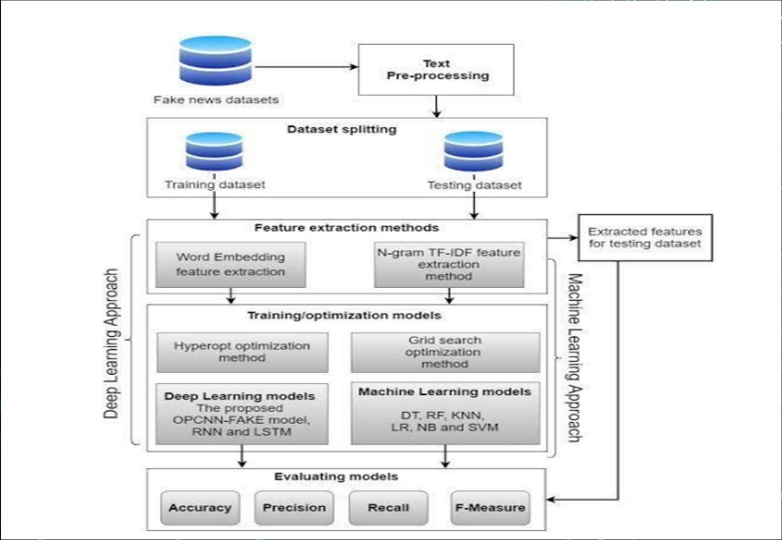
Architecture

Slide 13
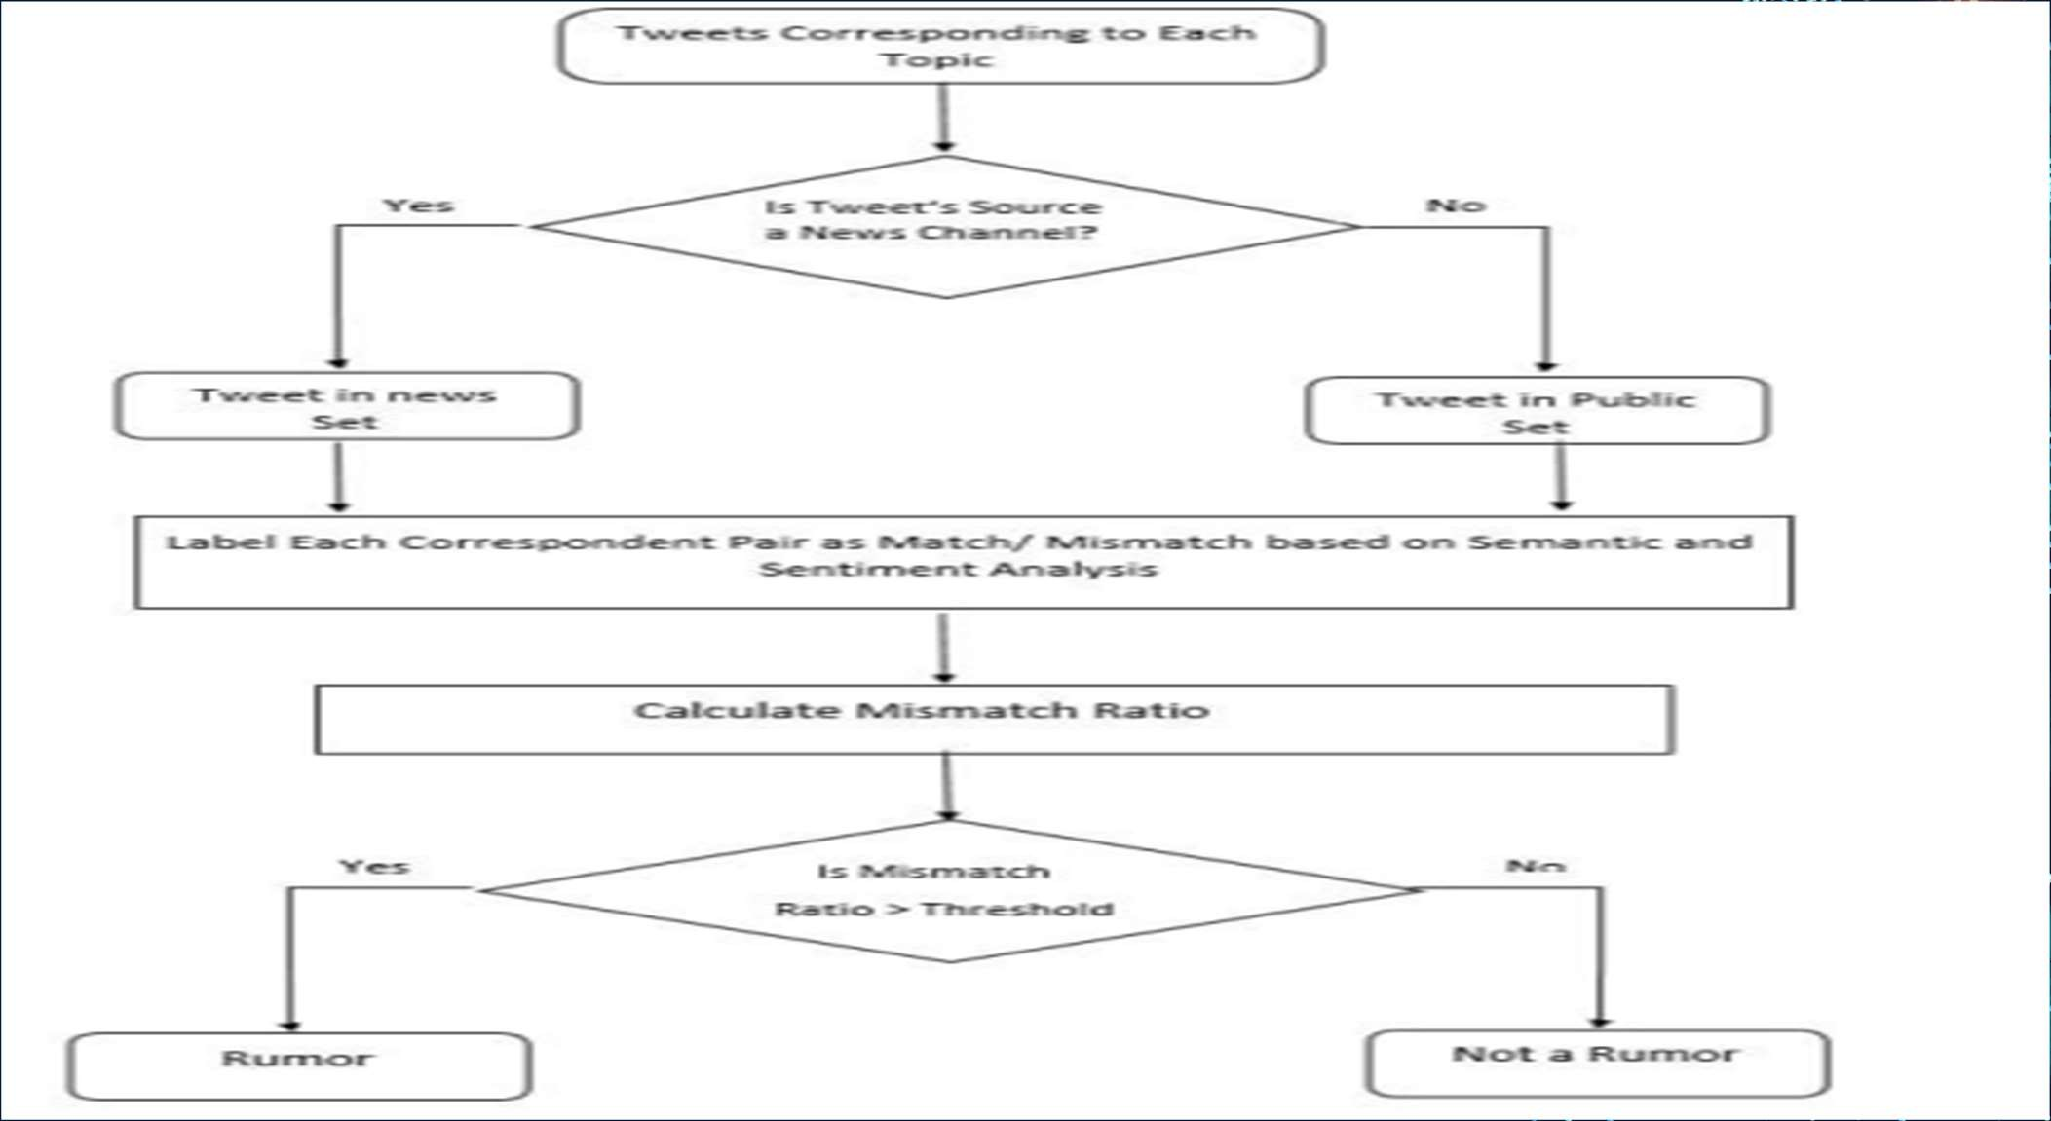
Flow chart

Slide 14
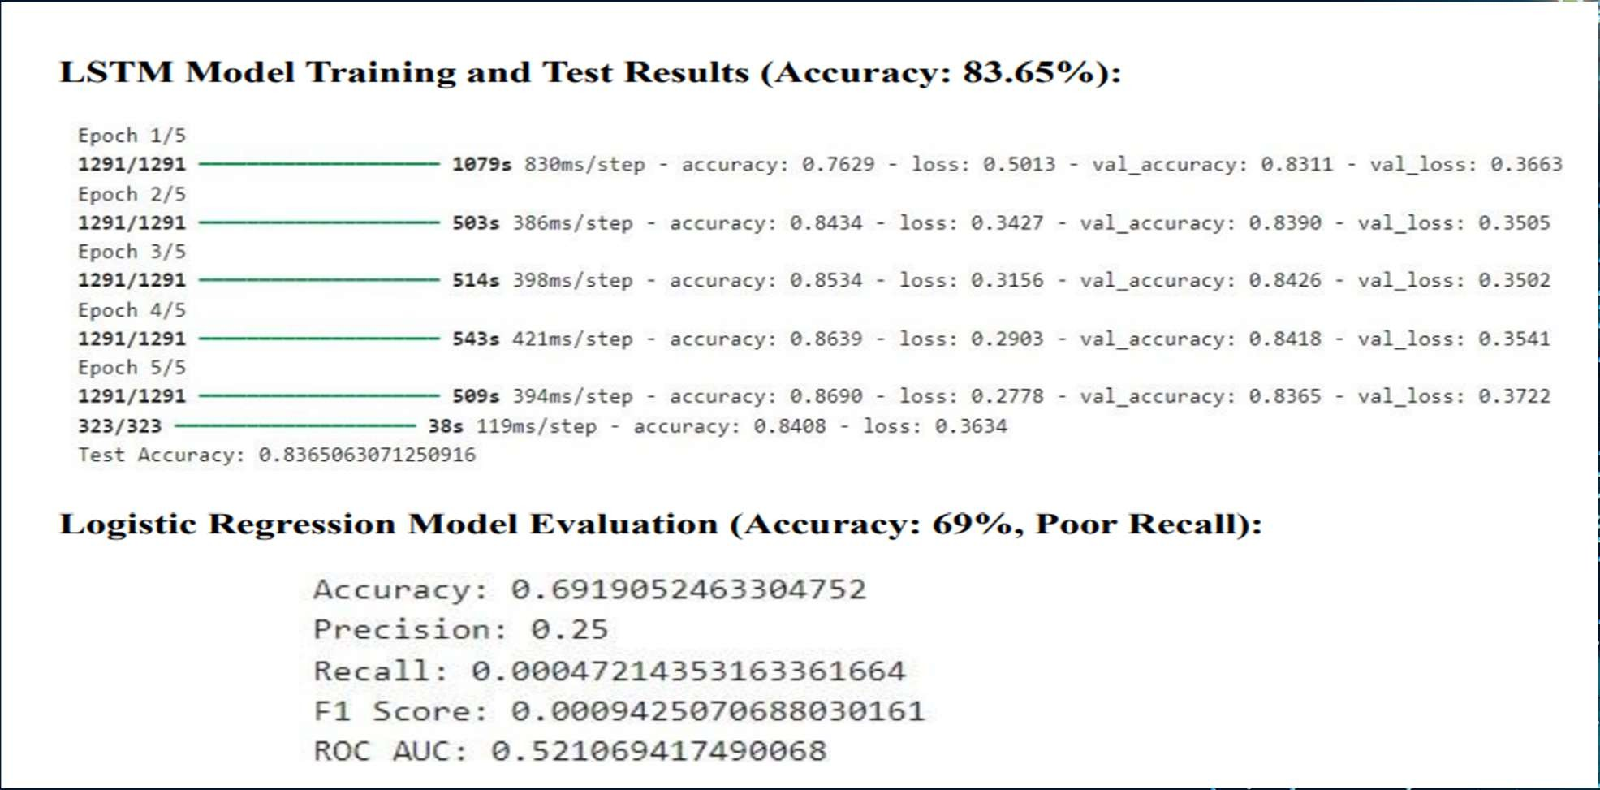
Results

Slide 15
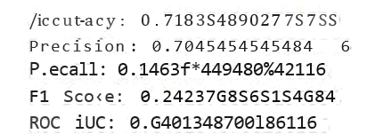
Decision Tree Model Evaluation (Moderate Performance, FI Score: 0.39):
Accuracy: 0.6184663081916388
Precision: 0.38S010S7721365S7 Recall: 0.O0l007239S3 i5l7A
Score: 0.39284613012642616 ROC AUC : 0.?567S36196ZS3S9
Random Forest Model Evaluation (Accuracy: 71.84%, Low Recall: 14.64%):

Slide 16
Model Comparison
Model | Evaluati on Metric (Accurac y) | Previous Work (Accurac y) | Evaluati on Metric (Precisio n) | Previous Work (Precisio n) | Evaluati on Metric (Recall) | Previous Work (Recall) | Evaluati on Metric (F1 Score) | Previous Work (F1 Score) | Evaluati on Metric (ROC AUC) | Previous Work (ROC AUC)
Decision Tree | 61.85% | 58.00% | 38.51% | 35.00% | 40.10% | 35.00% | 39.28% | 35.00% | 55.67% | 50.00%
Random Forest | 71.84% | 65.00% | 70.45% | 65.00% | 14.64% | 10.00% | 24.37% | 20.00% | 64.01% | 58.00%
LSTM | 83.65% | 80.00% | 0% | 0% | 0.00% | 0% | 0.00% | 0% | 0.00% | 0.00%
Logistic Regressi on | 69.10% | 60.00% | 25% | 22.00% | 0.00% | 0.00% | 0.00% | 0.00% | 52.17% | 50.00%

Slide 17
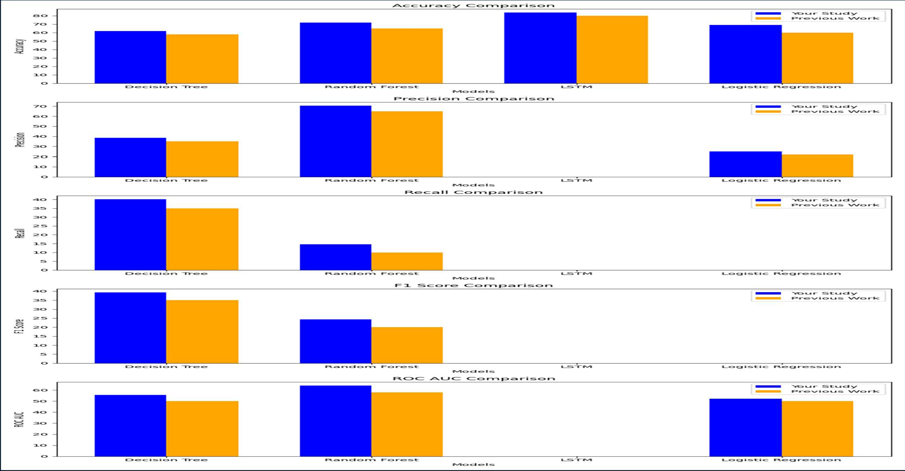
Comparison

Slide 18
Conclusion
Evaluated machine learning (Logistic Regression, Random Forest, Decision Tree) vs. deep learning (LSTM) models for rumor detection.
LSTM outperformed traditional models in capturing the sequential nature of text and understanding word relationships, unlike traditional models that treat text as a "bag of words.
LSTM showed higher recall and F1 score, leading to better detection of true rumors and fewer false negatives compared to Random Forest.Random Forest performed well but lagged behind LSTM in terms of recall and F1 score.
LSTM is better suited for detecting subtle patterns in rumors.
Future research could explore attention mechanisms and generative models for further improvements in accuracy and efficiency.

Slide 19
Future Scope
Building upon the success of LSTM and Random Forest in this project, several future directions can be explored to further enhance rumor detection on social networks:
Hybrid Models: Combining the strengths of LSTM and Random Forest could lead to even more robust performance
.
For example, LSTM could be used to extract deep features from text data, which could then be fed into a Random Forest classifier for final prediction.
Ensemble Methods: Experimenting with different ensemble techniques, such as stacking or bagging, could improve generalization and reduce overfitting.
Multimodal Approaches: Incorporating additional modalities, such as images or videos could provide valuable contextual information and improve detection accuracy.
Real-time Detection: Developing real-time rumor detection systems would enable timely intervention and mitigation of the spread of misinformation. This would require efficient algorithms and scalable architectures.

Slide 20
REFERENCE
1.Buntain, C., & Golbeck, J. (2017). Automatically identifying fake news in popular Twitter threads. Proceedings of the IEEE International Conference on Smart Cloud (pp.208-215).
2. Kumar, S., & Shah, N. (2018). False information on web and social media: A survey. Social Media Analytics: Advances and Applications, 15(4), 35-55.
3. Zubiaga, A., Aker, A., Bontcheva, K., Liakata, M., & Procter, R. (2018). Detection and resolution of rumors in social media: A survey. ACM Computing Surveys, 51(2), 1-36.
4. Ma, J., Gao, W., Wei, Z., Lu, Y., & Wong, K. F. (2016). Detect rumors using time series of social context information on microblogging websites. Proceedings of the 24th ACM International on Conference on Information and Knowledge Management (pp.17511754).
5. Shu, K., Sliva, A., Wang, S., Tang, J., & Liu, H. (2017). Fake news detection on socialmedia: A data mining perspective. ACM SIGKDD Explorations Newsletter, 19(1), 22 36.

